Slide 2
Biologically inspired algorithms Exercise 5
Ing. Lenka Skanderová, Ph. D.

Slide 3
Content
Differential Evolution

Slide 4

Differential Evolution – Control Parameters
$NP …$number of individuals
$G_{maxim}$… number of generation cycles
$F$ … mutation constant (also denoted as scaling factor)
$CR$… crossover range

Slide 5
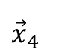
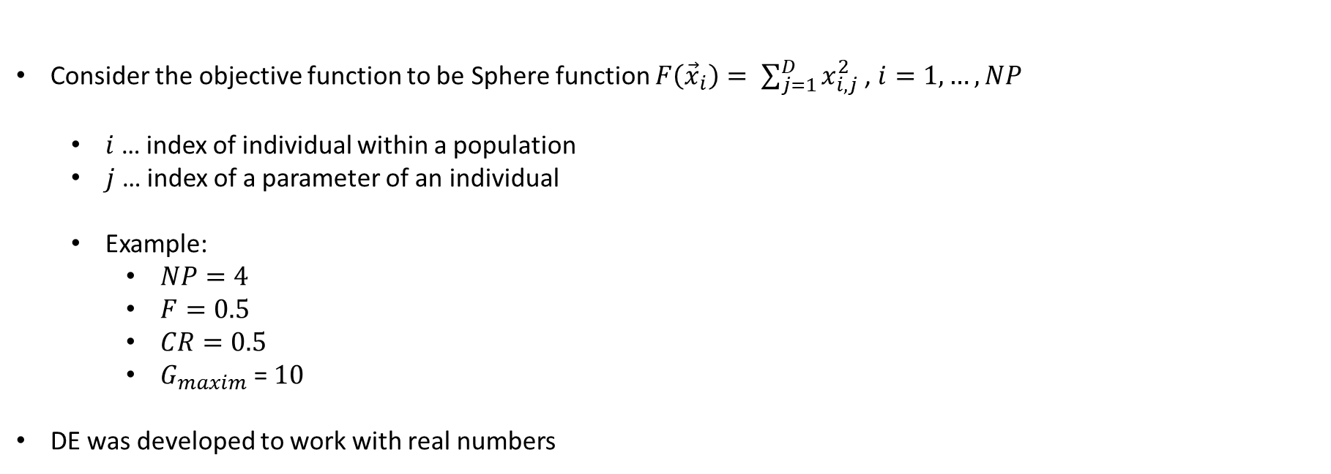
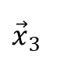
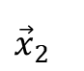
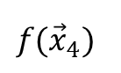
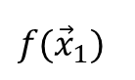
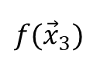
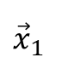
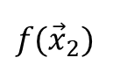
Differential Evolution – Individual and Population
Consider the objective function to be Sphere function $F\left({\vec{x}}_{i}\right)= \sum_{j=1}^{D}{x_{i,j}^{2} }$, $i=1, …, NP$
$i$ … index of individual within a population
$j$ … index of a parameter of an individual
Example:
$NP=4$
$F=0.5$
$CR=0.5$
$G_{maxim}$ = $10$
DE was developed to work with real numbers
Individuals (solutions) representation
$${\vec{x}}_{1}$$
$${\vec{x}}_{2}$$
$${\vec{x}}_{3}$$
$${\vec{x}}_{4}$$
3.4
2.0
5.1
0.5
2.5
4.5
3.3
0.7
1.0
1.0
2.4
1.2
5.0
6.0
1.8
1.1
2.2
5.0
4.1
0.0
$$f({\vec{x}}_{1})$$
48.65
$$f({\vec{x}}_{2})$$
86.25
$$f({\vec{x}}_{3})$$
62.71
$$f({\vec{x}}_{4})$$
3.39

Slide 6
Differential Evolution – Pseudocode – Main Loop
pop = Generate NP random individuals (you can use the class Solution mentioned in Exercise 1)
g = 0
while g < g_maxim :
new_pop = deepcopy(pop) # new generation
for each i, x in enumerate(pop): # x is also denoted as a target vector
r1, r2, r3 = select random indices(from 0 to NP-1) such that r1!=r2!=r3!=i
v = (x_r1.params – x_r2.params)*F + x_r3.params # mutation vector. TAKE CARE FOR BOUNDARIES!
u = np.zeros(dimension) # trial vector
j_rnd = np.random.randint(0, dimension)
for j in range(dimension):
if np.random.uniform() < CR or j == j_rnd:
u[j] = v[j] # at least 1 parameter should be from a mutation vector v
else:
u[j] = x_i.params[j]
f_u = Evaluate trial vector u
if f_u is better or equals to f_x_i: # We always accept a solution with the same fitness as a target vector
new_x = Solution(dimension, lower_bound, upper_bound)
new_x.params = u
new_x.f = f_u
pop = new_pop
g += 1

Slide 7
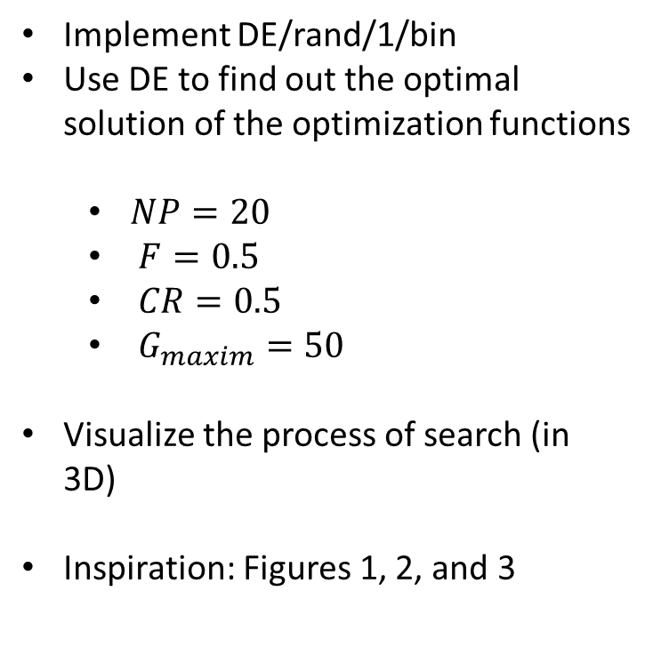
Task
Implement DE/rand/1/bin
Use DE to find out the optimal solution of the optimization functions
$NP=20$
$F=0.5$
$CR=0.5$
$G_{maxim}=50$
Visualize the process of search (in 3D)
Inspiration: Figures 1, 2, and 3
Figure 2
Figure 1
Figure 3

Slide 8
Thank you for your attention
Ing. Lenka Skanderová, Ph.D.
EA 407
+420 597 325 967
lenka.skanderova@vsb.cz
homel.vsb.cz/~ska206

